Slide 1
Cells: THE BASIC UNITS OF LIFE
New Textbook Pages- 37-63
Old Textbook Pages- 58-75

Slide 2
The Diversity of cells
A cell is the smallest unit that can perform all processes necessary for life.
Robert Hooke was the first person to describe cells. In 1965 he built a microscope to look at tiny objects.
One day he looked at a thin slice of cork and saw tiny little boxes which he named cells.
Anton van Leeuwenhoek created a microscope and used it to explore pond water.
He discovered single celled organisms which today we call protists. He also looked a blood cells from different types of animals.
Several other scientists and their discoveries lead to Cell Theory.

Slide 3
Cell Theory
All organisms are made of one or more cells.
The cell is the basic unit of all living things.
All cells come from existing cells.

Slide 4
Cell Size
Most cells are to small to be seen without a microscope. However, a few are big and can be seen with the human eye.

Slide 5
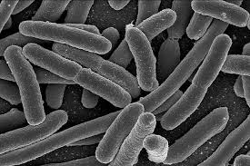
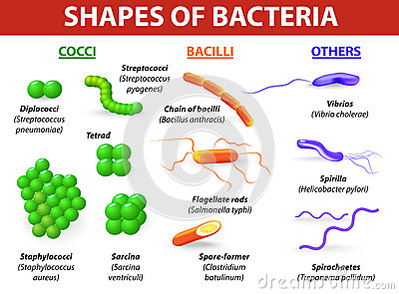
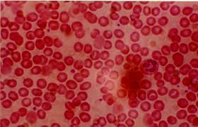
Types of cells
Yeast Cells
Blood Cells
Bacteria Cells
Blood cells in fish, birds, and frogs are oval and blood cells in humans and dogs are round and flat.

Slide 6
Parts OF A CELL
Cell Membrane and Cytoplasm
All cells are surrounded by a cell membrane.
It is a protective layer that covers the cells surface and acts as a barrier. It separates the cells contents from the surrounding environment.
Inside the cell there is fluid, this fluid and almost all of its content its called the Cytoplasm.

Slide 7
Parts of a cell
Organelles
Genetic Material
Cells have organelles that carry out various life processes.
Organelles are structures that perform specific tasks and functions within a cell.
Different types of cells have different types of organelles.
All cells contain DNA (deoxyribonucleic acid).
It carries information needed to make new cells.
In some cells the DNA is enclosed inside the an organelle called the nucleus. Bacteria cells do not have a nucleus.

Slide 8
TWO KINDS OF CELLS
All cells have cell membranes, organelles, cytoplasm, and DNA.
But there are two basic types of cells.
Cells with no nucleus= Prokaryotic
Cells that have a nucleus= Eukaryotic

Slide 9
Prokaryotes
Bacteria and archaea are prokaryotes.
Prokaryotes are single celled organisms that do not have a nucleus or membrane bound organelles.
The most common prokaryotes are bacteria. Bacteria are the smallest cells known and they can live almost everywhere.
Archaea cells are found in extremely high temperatures of deep-sea volcanic vents.

Slide 10
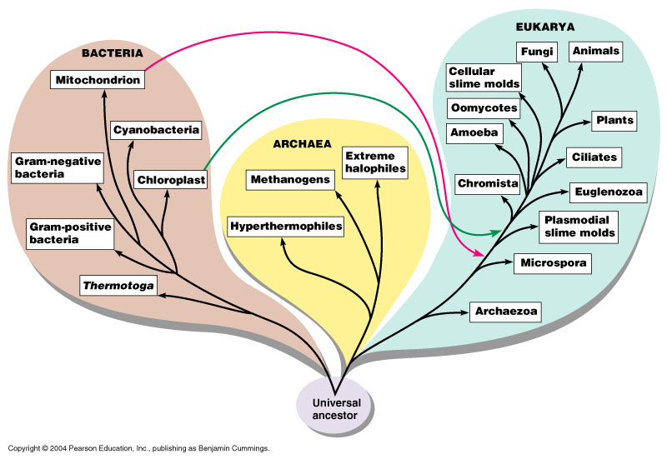

Slide 11
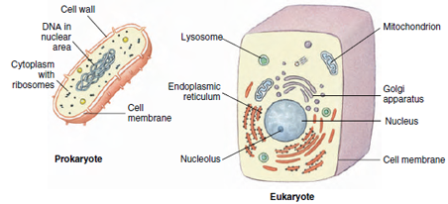
Eukaryotes
Eukaryotic cells are the largest cells.
Unlike prokaryotes (bacteria and archaea) eukaryotes have a membrane bound nucleus and other membrane bound organelles.
All living things that are not bacteria or archaea have eukaryotic cells.
Many eukaryotes are multicellular and complex but some yeasts or protists such as amoebas are considered single-celled eukaryotes.

Slide 12
