Slide 1
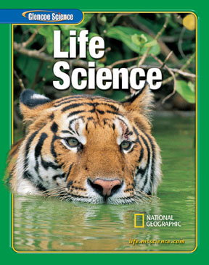

Slide 2
Table of Contents
Chapter: Interactions of Life
Section 1: Living Earth
Section 2: Populations
Section 3: Interactions Within Communities

Slide 3
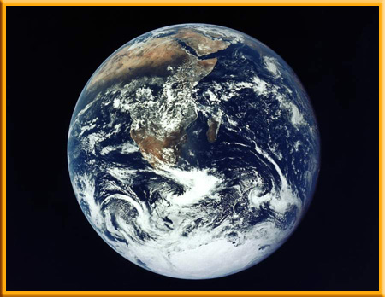
Living Earth
1
The Biosphere
The part of Earth that supports life is the biosphere (BI uh sfihr).
The biosphere includes the top portion of Earth’s crust, all the waters that cover Earth’s surface, and the atmosphere that surrounds Earth.

Slide 4
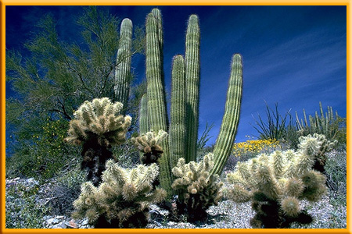
Living Earth
1
The Biosphere
The biosphere is made up of different environments that are home to different kinds of organisms.
For example, desert environments receive little rain.
Cactus plants, coyotes, and lizards are included in the life of the desert.

Slide 5
Living Earth
1
Life on Earth
The amount of energy that reaches Earth from the Sun helps make the temperature just right for life.
Mercury, the planet closest to the Sun, is too hot during the day and too cold at night to make life possible there.

Slide 6
Living Earth
1
Life on Earth
Venus, the second planet from the Sun, has a thick, carbon dioxide atmosphere and high temperatures.
Mars is much colder than Earth because it is farther from the Sun and has a thinner atmosphere.

Slide 7
Living Earth
1
Life on Earth
The planets beyond Mars probably do not receive enough heat and light from the Sun to have the right conditions for life.

Slide 8
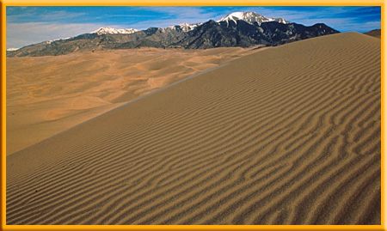
Living Earth
1
Ecosystems
An ecosystem consists of all the organisms living in an area, as well as the nonliving parts of that environment.

Slide 9
Living Earth
1
Ecosystems
Ecology is the study of interactions that occur among organisms and their environments.
Ecologists are scientists who study these interactions.

Slide 10
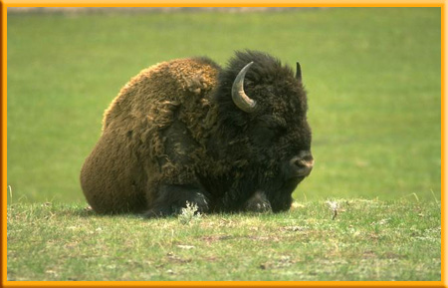
Living Earth
1
Populations
A population is made up of all organisms of the same species that live in an area at the same time.
For example, all the bison in a prairie ecosystem are one population.

Slide 11
Living Earth
1
Populations
All the cowbirds in this ecosystem make up a different population.
The grasshoppers make up yet another population.
Ecologists often study how populations interact.

Slide 12
Living Earth
1
Populations
A community is all the populations of all species living in an ecosystem.
An arctic community might include populations of fish, seals that eat fish, and polar bears that hunt and eat seals.

Slide 13
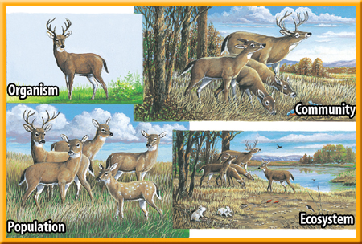
Living Earth
1
Populations
This figure shows how organisms, populations, communities, and ecosystems are related.

Slide 14
Living Earth
1
Habitats
Each organism in an ecosystem needs a place to live.
The place in which an organism lives is called its habitat.
An organism’s habitat provides the kinds of food and shelter, the temperature, and the amount of moisture the organism needs to survive.

Slide 15
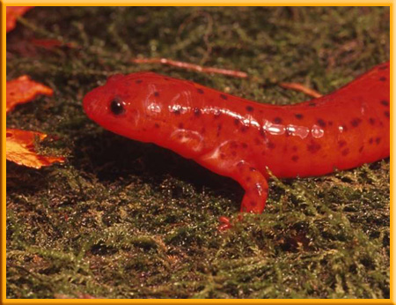
Living Earth
1
Habitats
The salamander’s habitat is the forest floor, beneath fallen leaves and twigs.
Salamanders avoid sunlight and seek damp, dark places.

Slide 16
Section Check
1
Question 1
Earth’s _____ includes the top part of Earth’s crust, all the waters covering Earth’s surface, and the atmosphere surrounding Earth.
A. biosphere
B. carrying capacity
C. ecosystem
D. limiting factor

Slide 17
Section Check
1
Answer
The correct answer is A. The biosphere is defined as the part of Earth that supports life and living things.

Slide 18
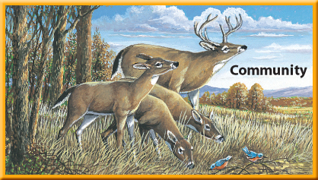
Section Check
1
Question 2
This illustration can be used to represent a forest community because it _______.

Slide 19
Section Check
1
A. shows birds gathering twigs to make nests.
B. shows clouds representing rainfall.
C. shows deer grazing on grass.
D. shows many different populations living
together.

Slide 20
Section Check
1
Answer
The correct answer is D. A community includes the populations of all species that live in a particular ecosystem. The illustration shows populations of deer, blue birds, and various species of plants.

Slide 21
Section Check
1
Question 3
What kind of scientist would study how bison grazing on prairie grass affect the grasshoppers that lived in the prairie?
Answer
Ecologists study interactions that occur among organisms and their environment.

Slide 22
Populations
2
Competition
Crickets require plenty of food, water, and hiding places.
As a population of caged crickets grows, extra food and more hiding places are needed.
Some crickets might have to be moved to other cages.

Slide 23
Populations
2
Food and Space
Organisms living in the wild do not always have enough food or living space.

Slide 24
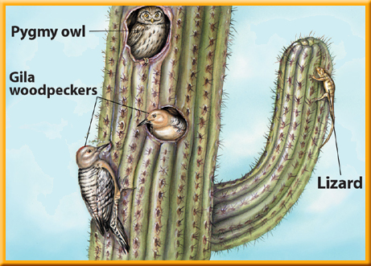
Populations
2
Food and Space
Woodpeckers must compete with each other for nesting spots.
Competition occurs when two or more organisms seek the same resource at the same time.

Slide 25
Populations
2
Growth Limits
Competition limits population size.
In nature, the most intense competition is usually among individuals of the same species, because they need the same kinds of food and shelter.

Slide 26
Populations
2
Growth Limits
Competition also takes place among different species.
For example, after a Gila woodpecker has
abandoned its nest, owls, flycatchers, snakes, and lizards might compete for the shelter of the empty hole.

Slide 27
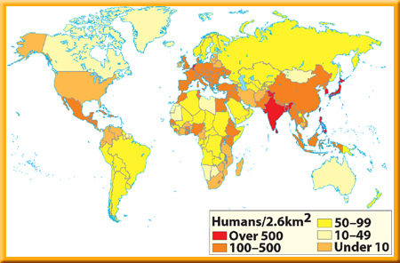
Populations
2
Population Size
This map shows human population density.

Slide 28
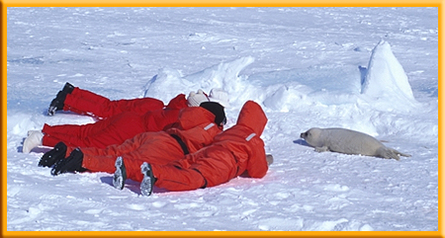
Populations
2
Measuring Populations
Ecologists can have problems when measuring wildlife populations.
One of the methods they use is called trap-mark-release.

Slide 29
Populations
2
Limiting Factors
In any ecosystem the availability of food, water, living space, mates, nesting sites, and other resources is often limited.
A limiting factor is anything that restricts the number of individuals in a population.
Limiting factors include living and nonliving features of the ecosystem.

Slide 30
Populations
2
Limiting Factors
A limiting factor can affect more than one population in a community.
Suppose a lack of rain limits plant growth in a meadow.
Fewer plants produce fewer seeds.

Slide 31
Populations
2
Limiting Factors
For seed-eating mice, this reduction in the food supply could become a limiting factor.
A smaller mouse population could, in turn, become a limiting factor for the hawks and owls that feed on mice.

Slide 32
Populations
2
Carrying Capacity
Carrying capacity is the largest number of individuals of one species that an ecosystem can support over time.
If a population begins to exceed the environment’s carrying capacity, some individuals will not have enough resources. They could die or be forced to move elsewhere.
Click image to view movie.

Slide 33
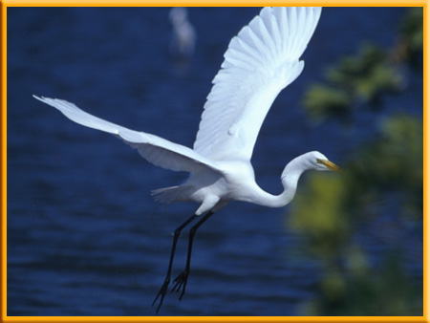
Populations
2
Moving Around
Most animals can move easily from place to place, and these movements can affect population size.
Many bird species move from one place to another during their annual migrations.

Slide 34
Populations
2
Moving Around
Even plants and microscopic organisms can move from place to place, carried by wind, water, or animals.
The tiny spores of mushrooms, mosses, and ferns float through the air.

Slide 35
Populations
2
Exponential Growth
When a species moves into a new area with plenty of food, living space, and other resources, the population grows quickly, in a pattern called exponential growth.

Slide 36
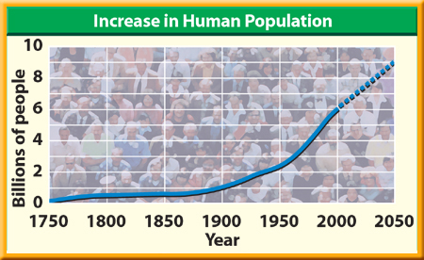
Populations
2
Exponential Growth
Exponential growth means that the larger a population gets, the faster it grows.
Over time, the population will reach the ecosystem’s carrying capacity for that species.

Slide 37
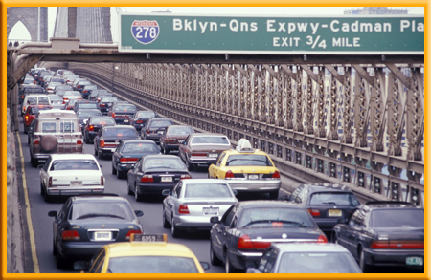
Populations
2
Exponential Growth
You probably have read about or experienced some of the competition associated with
human population growth, such as freeway traffic jams, crowded subways, and buses, or housing shortages.

Slide 38
Populations
2
Exponential Growth
As population density increases, people are forced to live closer to one another.
Infectious diseases can spread easily when people are crowded together.

Slide 39
Section Check
2
Question 1
How might competition with the owl and woodpecker limit the growth of the population of the lizards shown in this illustration?

Slide 40
Section Check
2
A. there would be more competition for food
B. there would be more competition for nesting
spaces
C. there would be more competition for sunlight
D. there would be more competition for water

Slide 41
Section Check
2
Answer
The correct answer is B. All three animals use the cactus for nesting spaces. If nesting spaces are limited, the lizards may not be able to raise young and their population size will be limited.

Slide 42
Section Check
2
Question 2
An ecologist measured 10 square meters of beach and counted 50 crabs. The scientist then multiplied 50 by 10 and estimated that there were 500 crabs on 100 square meters of beach. What tool was the ecologist using?
A. biotic count
B. capacity count
C. limiting count
D. sample count

Slide 43
Section Check
2
Answer
The correct answer is D. Sample counts are used to estimate the sizes of large populations.

Slide 44
Section Check
2
Question 3
Which has the highest biotic potential, a fish that can produce 4000 eggs a year or one that can produce 20 eggs a year?
Answer
The fish that can produce 4000 eggs a year has the highest biotic potential. Biotic potential is the highest rate of reproduction under ideal conditions.

Slide 45
Interactions Within Communities
3
Obtaining Energy
Living organisms need a constant supply of energy.
The energy that fuels most life on Earth comes from the Sun.
Some organisms use the Sun’s energy to create energy-rich molecules through the process of photosynthesis.

Slide 46
Interactions Within Communities
3
Obtaining Energy
The energy-rich molecules, usually sugars, serve as food.
When the molecules break apart⎯for example, during digestion⎯the energy in the chemical bonds is released to fuel life processes.

Slide 47
Interactions Within Communities
3
Producers
Organisms that use an outside energy source like the Sun to make energy-rich molecules are called producers.
Most producers contain chlorophyll (KLOR uh fihl), a chemical that is required for photosynthesis.

Slide 48
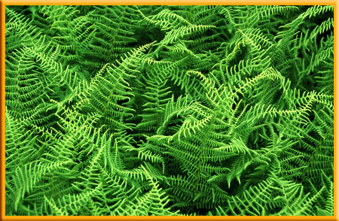
Interactions Within Communities
3
Producers
Green plants are producers.
Some producers do not contain chlorophyll and do not use energy from the Sun.
They make energy-rich molecules through a process called chemosynthesis (kee moh SIHN thuh sus).

Slide 49
Interactions Within Communities
3
Producers
These organisms can be found near volcanic vents on the ocean floor.
Inorganic molecules in the water provide the energy source for chemosynthesis.

Slide 50
Interactions Within Communities
3
Consumers
Organisms that cannot make their own energy-rich molecules are called consumers.
Consumers obtain energy by eating other organisms.

Slide 51
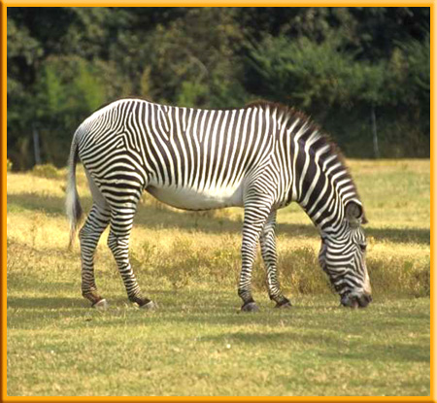
Interactions Within Communities
3
Consumers
Herbivores are the vegetarians of the world. They include rabbits, deer, and other plant eaters.

Slide 52
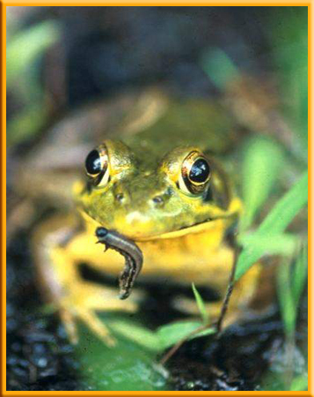
Interactions Within Communities
3
Consumers
Carnivores are animals that eat other animals. Frogs and spiders are carnivores that eat insects.
Omnivores, including pigs and humans, eat mostly plants and animals.

Slide 53
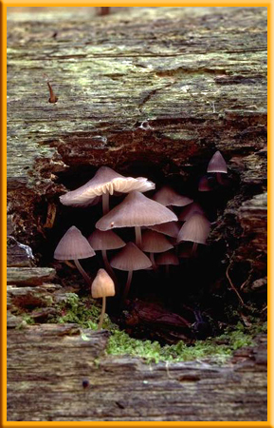
Interactions Within Communities
3
Consumers
Decomposers, including fungi, bacteria, and earthworms, consume wastes and dead organisms.

Slide 54
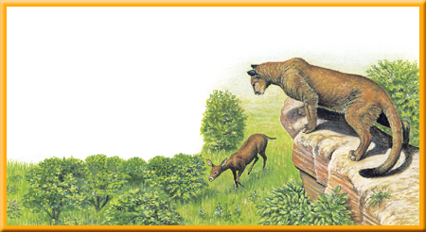
Interactions Within Communities
3
Food Chains
A food chain is a simple model of the feeding relationships in an ecosystem.
For example, shrubs are food for deer, and deer are
food for mountain lions.

Slide 55
Interactions Within Communities
3
Symbiotic Relationships
Many organisms live together and share resources in other ways.
Any close relationship between species is called symbiosis.

Slide 56
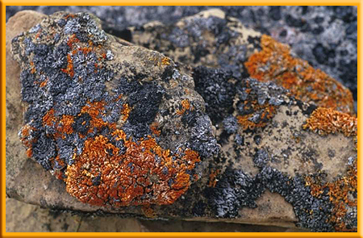
Interactions Within Communities
3
Mutualism
Lichens are made up of an alga or a cyanobacterium that lives within the tissues of a fungus.
Both organisms benefit from this association.
A symbiotic relationship in
which both species benefit
is called mutualism (MYEW chuh wuh lih zum.)

Slide 57
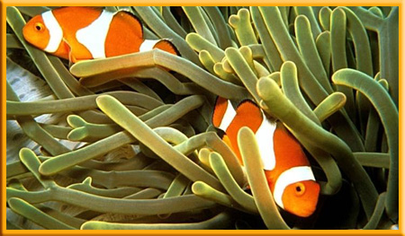
Interactions Within Communities
3
Commensalism
Anemones use their tentacles to capture shrimp, fish, and other small animals to eat.
Striped clown fish can swim among the tentacles without being harmed.
The anemone’s tentacles protect the clown fish from predators.

Slide 58
Interactions Within Communities
3
Commensalism
A symbiotic relationship in which one organism benefits and the other is not affected is called commensalisms (kuh MEN suh lih zum).

Slide 59
Interactions Within Communities
3
Parasitism
Roundworms, are common in puppies.
The roundworm attaches itself to the inside of the puppy’s intestine and feeds on nutrients in the puppy’s blood.

Slide 60
Interactions Within Communities
3
Parasitism
The puppy may have abdominal pain, bloating, and diarrhea.
A symbiotic relationship in which one organism benefits but the other is harmed is called parasitism (PER uh suh tih zum).

Slide 61
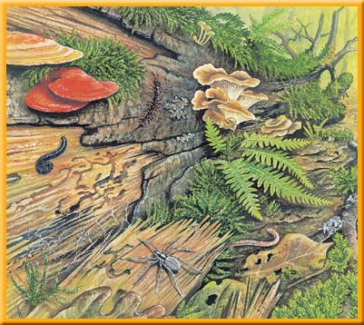
Interactions Within Communities
3
Niches
A rotting log in a forest can be home to many species of insects, including termites that eat decaying wood and ants that feed on the termites.
Other species that live on or under the rotting log include millipedes, centipedes, spiders, and worms.

Slide 62
Interactions Within Communities
3
Niches
Each species has different requirements for its survival. As a result, each species has its own niche (NICH).
An organism’s niche is its role in its environment⎯how it obtains food and shelter, finds a mate, cares for its young, and avoids danger.

Slide 63
Interactions Within Communities
3
Niches
Special adaptations that improve survival are often part of an organism’s niche.
When the caterpillars eat milkweed, they become slightly poisonous.
Birds avoid eating monarchs because they learn that the caterpillars and adults butterflies have an awful taste and can make them sick.

Slide 64
Interactions Within Communities
3
Predator and Prey
An organism’s niche includes how it avoids being eaten and how it finds or captures its food.
Predators are consumers that capture and eat other consumers.
The prey is the organism that is captured by the predator.

Slide 65
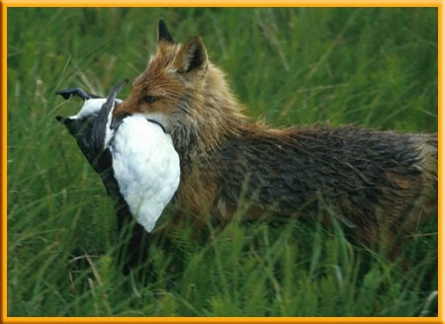
Interactions Within Communities
3
Predator and Prey
The presence of predators usually increases the number of different species that can live in an ecosystem.
Predators limit the size of prey populations.

Slide 66
Interactions Within Communities
3
Cooperation
Individual organisms often cooperate in ways that improve survival.
For example, a white-tailed deer that detects the presence of wolves or coyotes will alert the other deer in the herd.
These cooperative actions improve survival and are a part of the specie’s niche.

Slide 67
Section Check
3
Question 1
Fleas often live on dogs or cats and bite them for a meal of blood. This can be harmful to the cat or dog that is bitten. What type of symbiotic relationship is this?
Answer
This is an example of parasitism. In this type of relationship, one organism is harmed, while the other benefits.

Slide 68
Section Check
3
Question 2
How do producers that contain chlorophyll make energy rich molecules?
A. they use chemosynthesis
B. they use commensalism
C. they use mutualism
D. they use photosynthesis

Slide 69
Section Check
3
Answer
The correct answer is D. Green plants contain chlorophyll so that they can use the energy of the Sun for photosynthesis.

Slide 70
Section Check
3
Question 3
Which describes how predators affect an ecosystem?
A. decrease the number of niches in the
ecosystem
B. decrease the number of species in the
ecosystem
C. increase competition among species
D. limit the size of the prey population

Slide 71
Section Check
3
Answer
The correct answer is D. Because predators limit the prey populations, food and other resources are less likely to become scarce and competition between species is reduced.

