Slide 1
Energy Pyramids

Slide 2
Energy transfer
Energy is transferred from the sun to producers.
The producers use most of the energy to continue performing photosynthesis and to do cellular respiration.
What is not used can be passed on to consumers.

Slide 3
Energy transfer
Only 10% of the energy from producers is transferred to the primary consumer.
The primary consumer releases some of the energy as HEAT.
Some of that energy is used or stored by the organism.
The rest is passed on to the secondary consumer.

Slide 4
Energy transfer
Only 10% of the energy from the primary consumer is transferred to the secondary consumer.
The secondary consumer releases some of the energy as HEAT.
Some of that energy is used or stored by the organism.

Slide 5
Energy transfer
The transfer of energy from one organism to the next can be shown in an energy pyramid.

Slide 6
Trophic Levels
Each Level of an energy pyramid or food chain is called a trophic level.
EX: producer, primary consumer, secondary consumer etc…

Slide 7
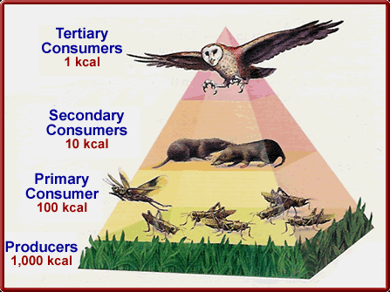

Slide 8
Your task today will be to
create an energy pyramid

