Slide 1
Ms. Ray
7th Grade Life Science Teacher
Wesley International Academy

Slide 2
Ms. Ray’s Classroom GUIDELINES and Procedures

Slide 3
Where Am I Supposed To Sit?
As you enter the room I will assign you a lab table (A-Z) and a number (1-4), you should walk directly to your assigned lab table and sit at your assigned seat number.
For example
Teacher: Welcome Johnny, you will be seated at lab table A seat number 2.
Johnny: walks directly to lab table A and sits at seat number 2.

Slide 4
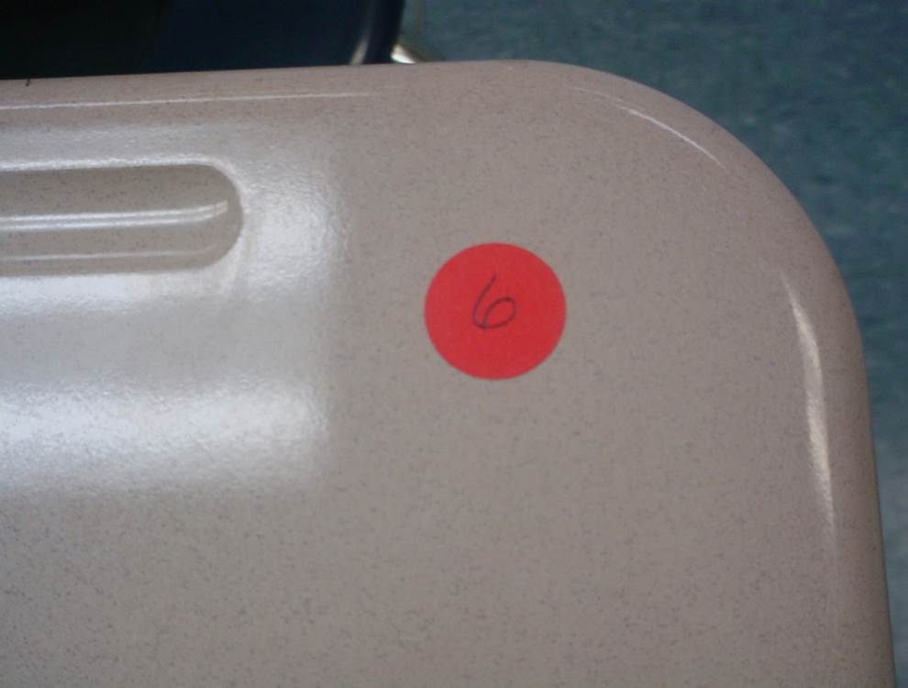

Slide 5
Ms. Ray’s Guidelines

Slide 6
Guideline 1
Be in your assigned seat and working on the assigned opening when the tardy bell rings.

Slide 7
Guideline 2
Bring ALL books and materials to class and take them with you when you leave.
Asking to borrow supplies is unacceptable and is a violation of my classroom rules and will result in a negative dojo point.

Slide 8
Guideline 3
Follow directions the first time they are given.
I will not repeat myself because you were not listening.

Slide 9
Guideline 4
Treat each person in this room with respect and dignity.
We are a family and I will not tolerate disrespectful and/or rude behavior.

Slide 10
Guideline 5
Once you enter my classroom you may not leave during instructional class time.
NO TO ALL OF THE FOLLOWING:
Restroom Breaks
Gathering Supplies(Homework, Paper, Pencils, etc.)
Water Breaks
Handle your personal business before or after you leave my class.

Slide 11
Guideline 6
Follow all procedures and policies as outlined in the APS and Wesley International Academy handbooks.

Slide 12
Special Guidelines
This classroom is a “No Whining Zone”. That means that there will be no whining, for ANY reason.
Do not make EXCUSES for not completing a task, I will not accept them!

Slide 13
Special Guidelines
DO NOT:
Sit in my stools
Ask me questions for the first 5 minutes of class unless it is an emergency!!!
Move my chairs
Purposely fall/ knock them over
Speak unless you were addressed~ Always Raise Your Hand and Think Before You Speak

Slide 14
Following My Guidelines Will Result In…..
Verbal acknowledgement
Positive DoJo Points
A stress-free learning environment
A pleasant and orderly classroom atmosphere

Slide 15
Choosing Not To Follow My Guidelines Will Result In The Following Consequences
A Verbal Warning
Negative DoJo Mark
Detention/ Silent Lunch/ Recess Removal/ Lab Activity Removal/ Field Trip Removal
Call/Conference With Your Parents
Administrative Referral

Slide 16
Severe Consequence Clause
Any student who uses profanity, fights, damages school property (this includes the property of the teacher and other students), or is disrespectful will be sent to the office IMMEDIATELY!

Slide 17
Ms. Ray’s Classroom Procedures

Slide 18
Entering The Room
Enter quietly.
Have a seat.
Take out your materials.
Start on the opening.
Write down homework in your agenda.

Slide 19
When You Are Tardy…
Enter quietly.
Excused: Place excuse in
the basket on my desk.
Unexcused:
Negative DoJo Point
Fill out the Tardy Log
Have a seat and take out
your materials.

Slide 20
Getting Your Attention
I will . . .
Stand in front of the class in the attention box.
Raise my hand.
Wait for everyone to be
quiet.
Begin speaking

Slide 21
Paper Heading
Name (First and Last)
Date
Class Period
PLUS: your assigned student number which goes at the top on the right side of every paper you turn in to me.

Slide 22
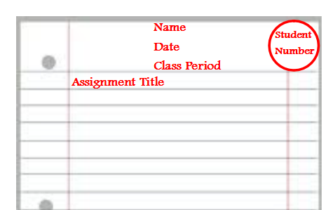

Slide 23
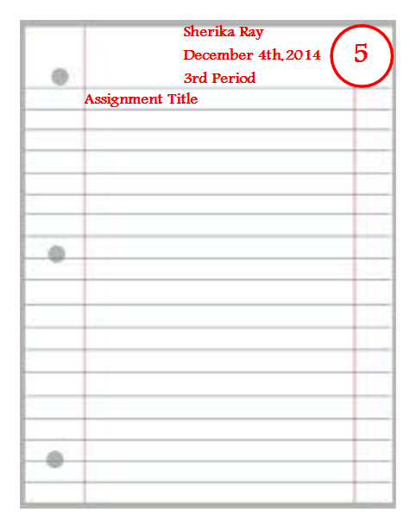

Slide 24
After an EXCUSED Absence
Go to the Absent Folder.
Copy the homework and classwork.
Retrieve any handouts.
Make-up work for unexcused
absences is not available.

Slide 25
You Don’t Have My Homework?
Student Responsibility Cards are for students who do not complete the assigned homework and or classwork.
Fill it out.
Sign and date it.
Turn it in with the homework and classwork papers.

Slide 26
Student Responsibility Card
Name: Date: Class Period
Completing all homework and classwork assignments is your responsibility as a student.
Missing Assignment: ____________________________________________
_____ I do not have my assignment today because:
_____ I did the assigned homework, but I did not bring it to class.
_____ I chose not to do my homework/ classwork assignment.
_____ I forgot to do my homework.
_____ I did not have the appropriate materials at home.
_____ Other—please explain below.
Signature _____________________________________Date:________________

Slide 27
Group/ Lab Roles
Leader/Spokesperson: This student is in charge of organizing the final product of the project, be it a paper, a presentation, etc. Make sure that the project meets the standards set out by the instructor (often as a rubric).
Recorder/Secretary: This person takes notes whenever the group meets and keeps track of group data/sources/etc. This person distributes these notes to the rest of the group highlighting sections relevant for their parts of the project.
Observer/Checker: Someone needs to double-check data, bibliographic sources, or graphics for accuracy and correctness.
Editor: This person would be responsible for the technical details of the final product and would be ready to summarize the group's progress and findings to the instructor and to other groups.
Facilitator/Encourager: This student gets discussion moving and keeps it moving, often by asking the other group members questions.
Summarizer/Note Taker: Every so often (perhaps once per question for a list of questions, or at the end for one question), this student provides a summary of the discussion for other students to approve or amend.
Elaborator: This person seeks connections between the current discussion and past topics or overall course themes.

Slide 28
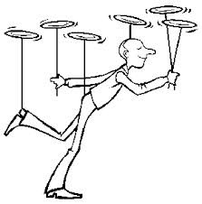
I Can’t Do It All…
I need assistants to help me.
________________
Paper Managers
(2 Students)
Classroom Managers
(2 Students)
Research Managers
(2 Students)

Slide 29
Paper Managers
Quietly and quickly pick up the papers.
Make sure all students have the proper heading.
Place papers in numerical order.
______________________________
Paper managers must work to complete their assigned work quickly and they must be able to complete a task swiftly yet effectively.

Slide 30
Research Managers
I do not have the answer to every question.
Research managers answer parking lot questions during the last 5-10 minutes of class using the computers.
_______________________________
Research managers must work to complete assignments swiftly and must have decent to good technology and computer skills.

Slide 31
Classroom Managers
Make sure the class runs smoothly for your class period and the next.
Classroom Managers may pass out papers, help to set up lab equipment, distribute supplies, staple/hole punches paper, and places copies of assignments and agendas in the absent folder.
________________________________
These are students who typically get to class early and do not mind leaving after everyone else. Students are also almost always present.

Slide 32
How To Become A Manager?
You must sign up and your classroom behavior must qualify and meet Ms. Ray’s standard.
________________________________
You Can Be Fired From Being A Manager!

